Slide 1
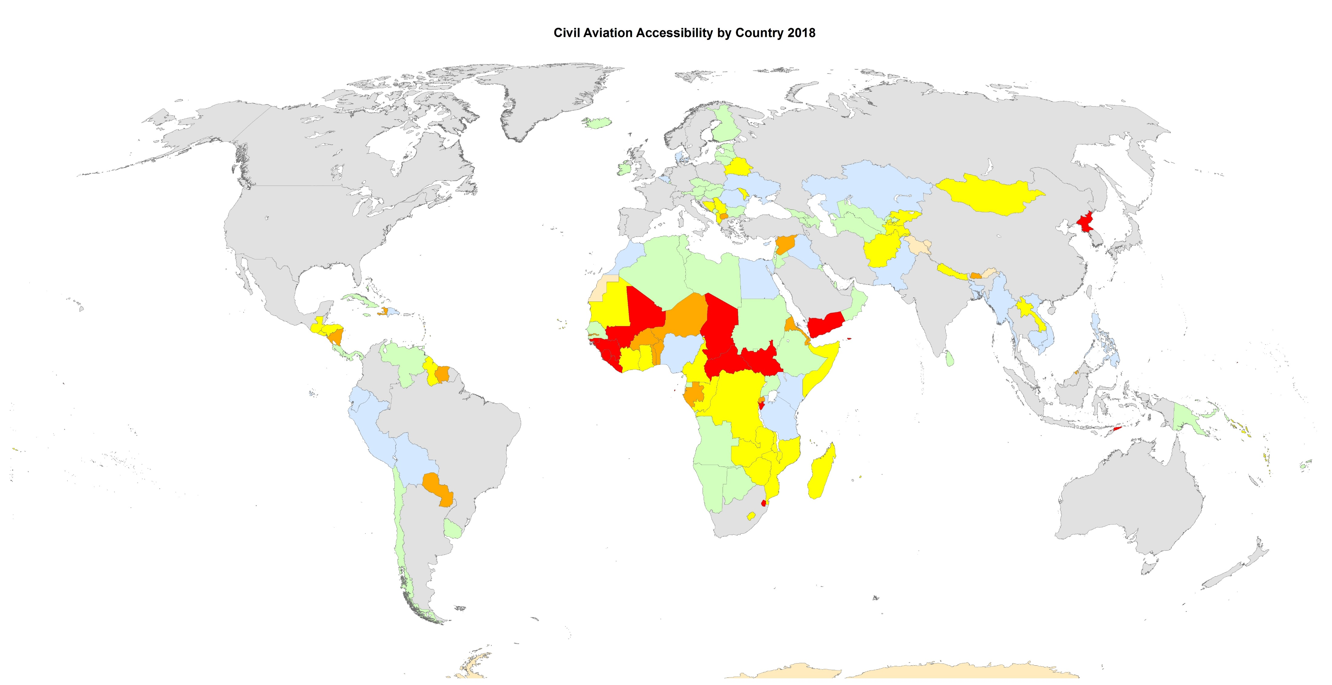
D – Upper Middle

Slide 2



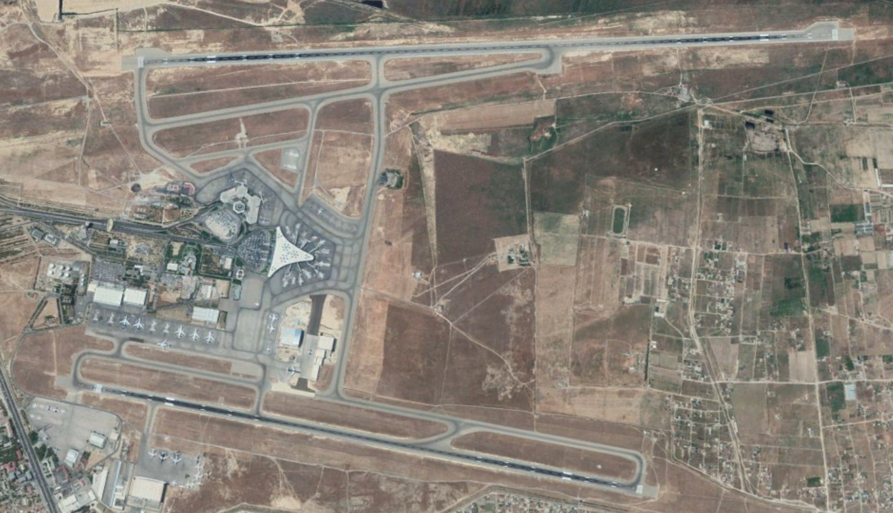

D – Upper Middle (54, 28.3%)
A big airport and a medium traffic around 50,000 flights per year.
Mainly small-size countries with a high income for the half.
More a support for the integration in their civil aviation environment.
Costa Rica with its three National Airlines
Azerbaijan with Baku INTL Airport

Slide 3
E – High

Slide 4
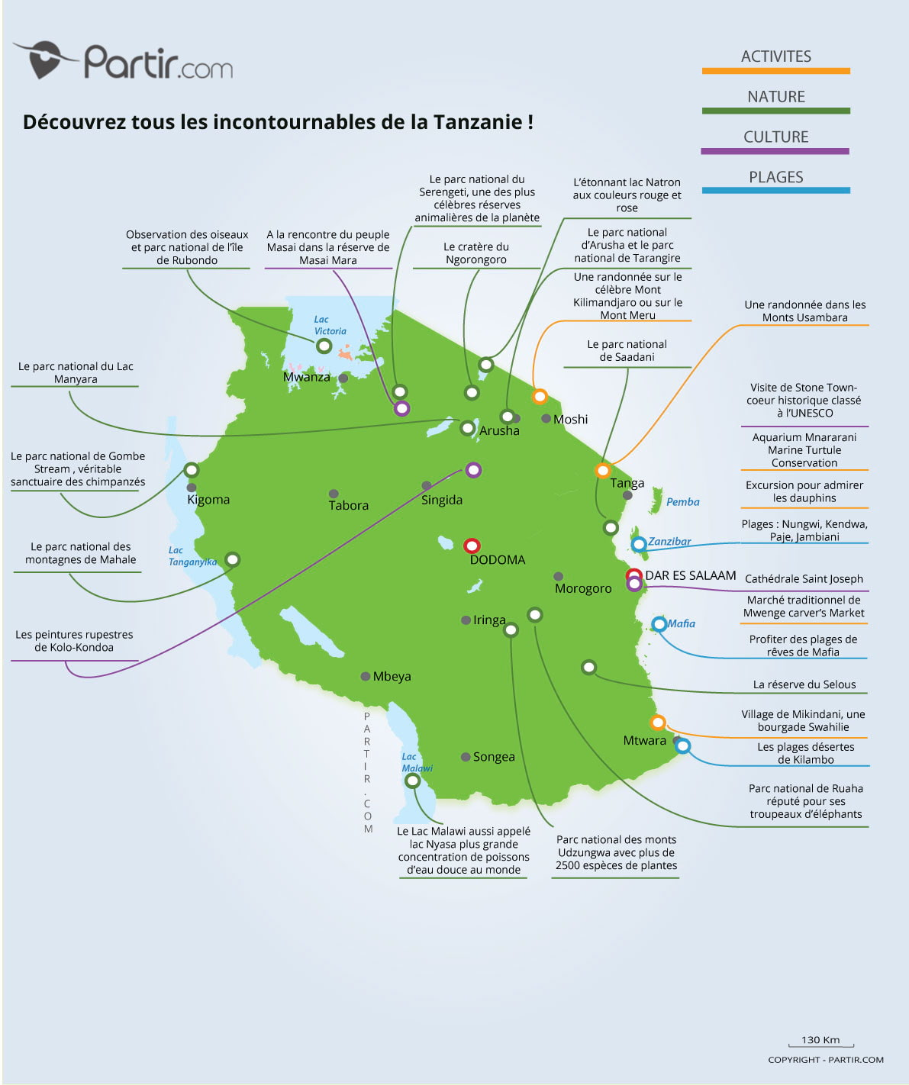

E – High (23, 12%)
More than one big airport and a medium traffic around 100,000 flights per year.
Mostly wealthy small-size countries or very touristic countries with a low income.
Not really need the ICAO technical support.
Peru with Jorge Chavez INTL Airport (Lima)
Touristic Map of United Republic of Tanzania

Slide 5
A – Very High

Slide 6
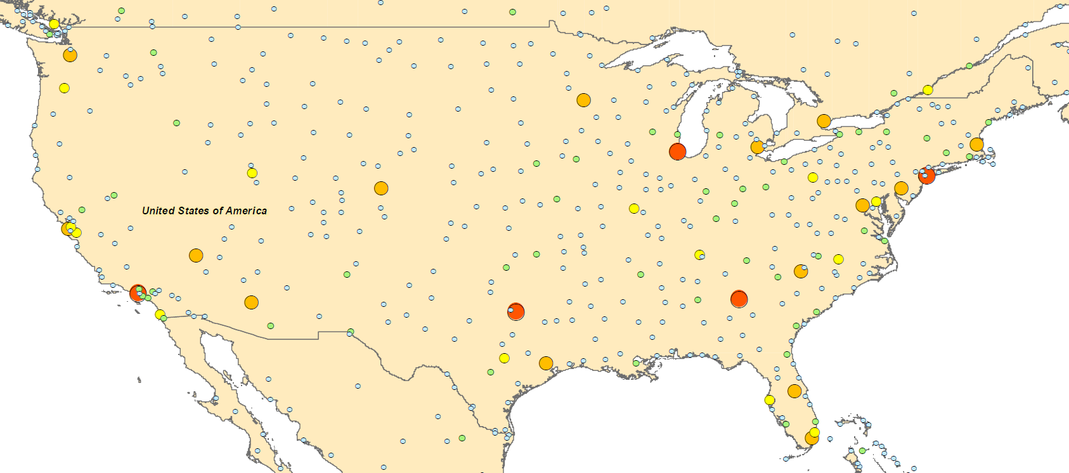
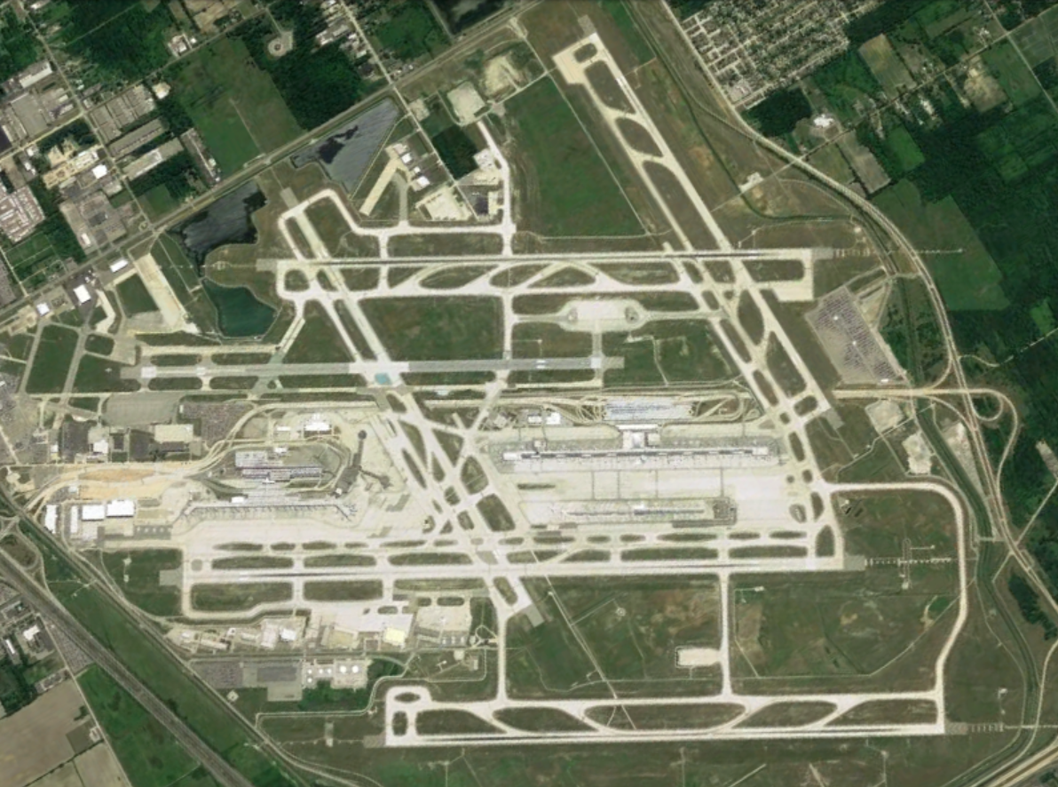
F – Very High (35, 18.3%)
A medium number of airport around 75 and between 100,000 & a few million of flights per year in the whole country.
All the world great powers or very wealthy average countries (mostly in Europe).
More susceptible to provide technical support to the ICAO than to receive some.
USA with Detroit Metropolitan Wayne County Airport
Airports in the USA

Slide 7
